Slide 1
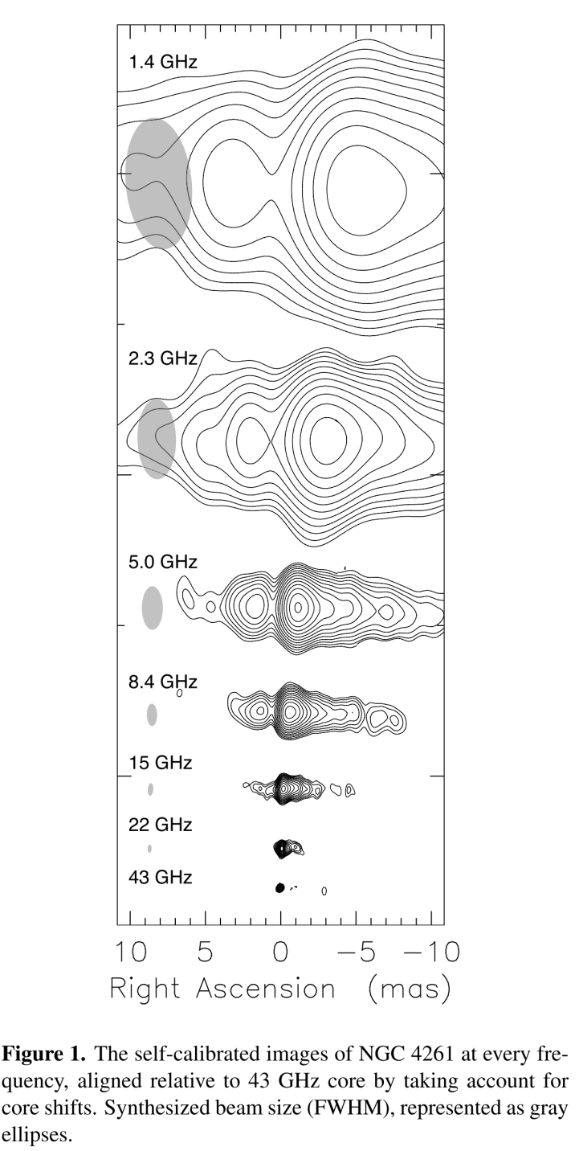
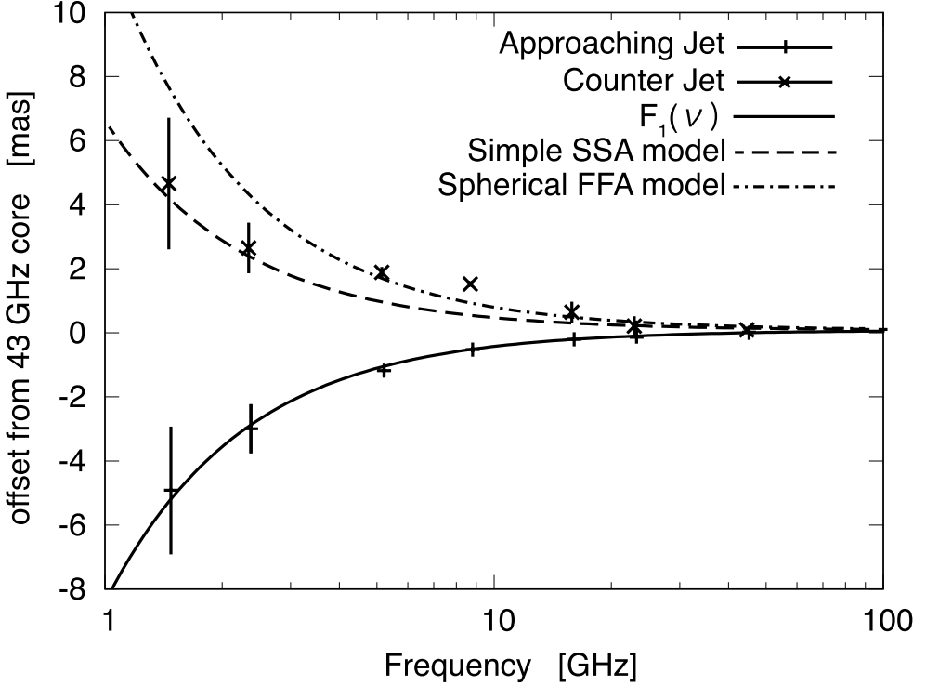
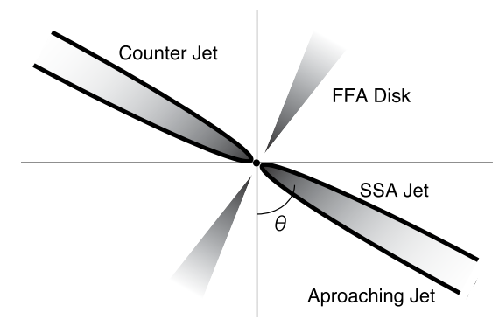
Core shift measurement of the AGN in NGC 4261
By measuring a double-sided jet, the authors can accurately pin down the location of the BH at the center of the jets.
Also, there seems to be additional adsorption for the counter-jet (causing additional core shift). They consider it to be additional adsorption by free-free adsorption in the disk.
Haga+, EPJWC, 61, 08004 (2013)
Haga+, EPJWC, 61, 08004 (2013)

Slide 2
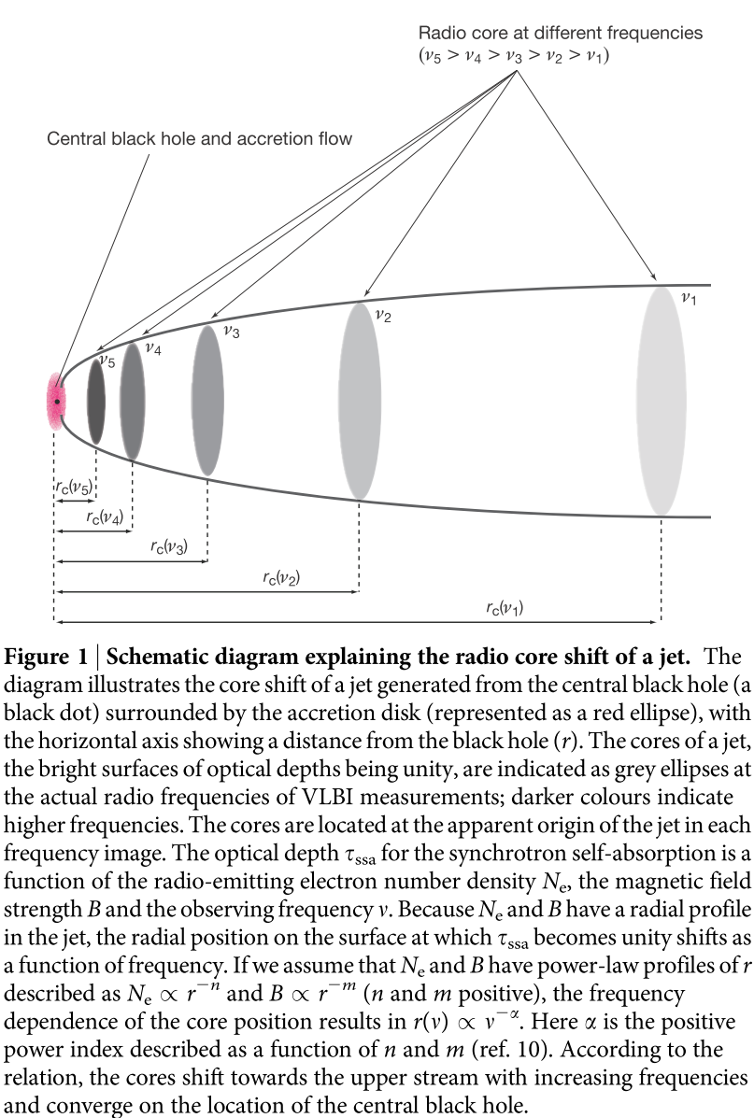
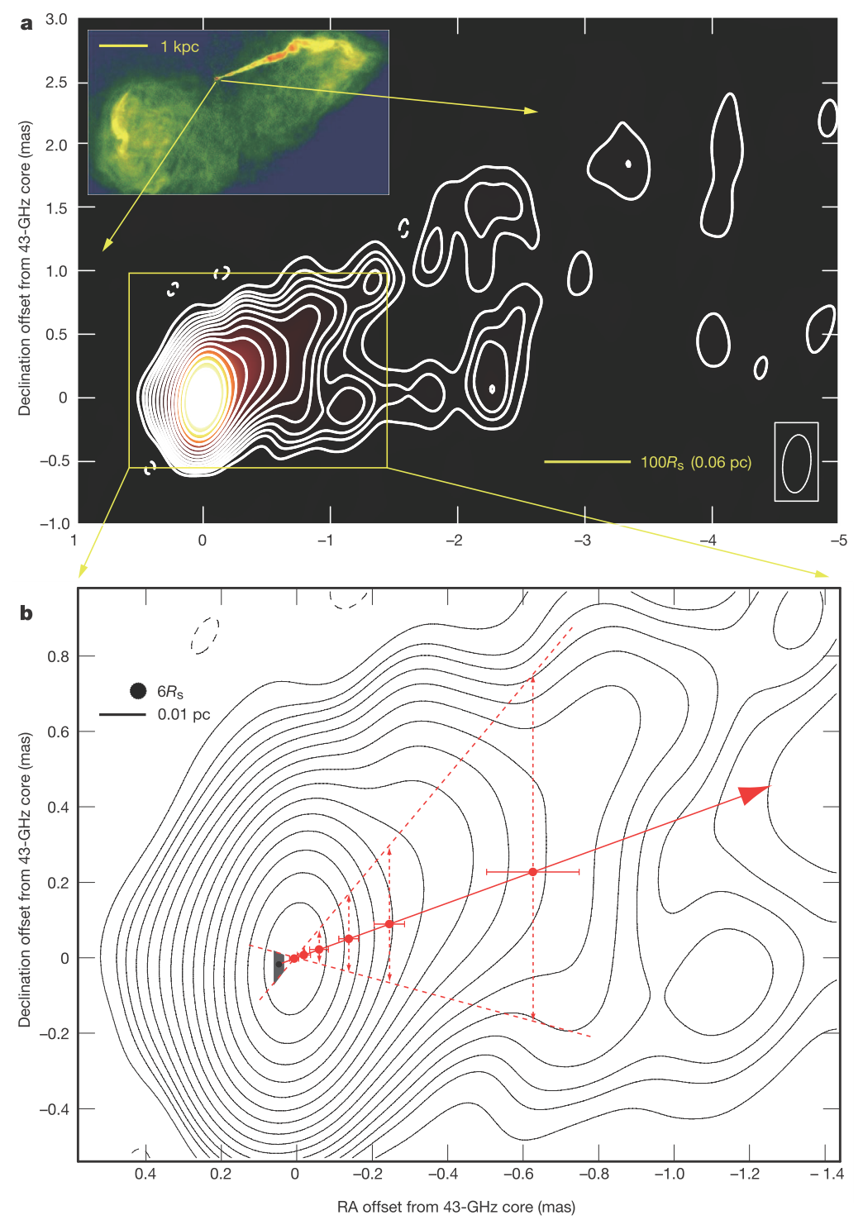
Core shifts
Hada+, Nature, 477, 185

Slide 3
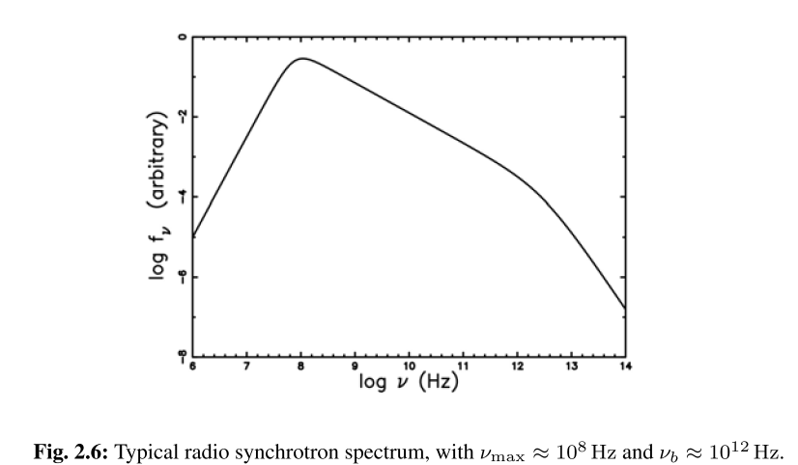
What is the meaning of the radio core?
The radio core is the position where a particular frequency is at its peak brightness.
It is typically taken to be the surface where $τ\sim 1$ for synchrotron self adsorption.
i.e. The core [of some frequency] is at a location where that frequency is the turnover frequency.
The implication of this is that, on the side of the core closer to the BH, the spectral index $α$ with $υ∝S^{α}$ is positive and on the other side, negative.
Turnover
frequency
Break
frequency
Optically
thick
emission
Optically thin power law
Synchrotron emission
Haga+, EPJWC, 61, 08004 (2013)

Slide 4
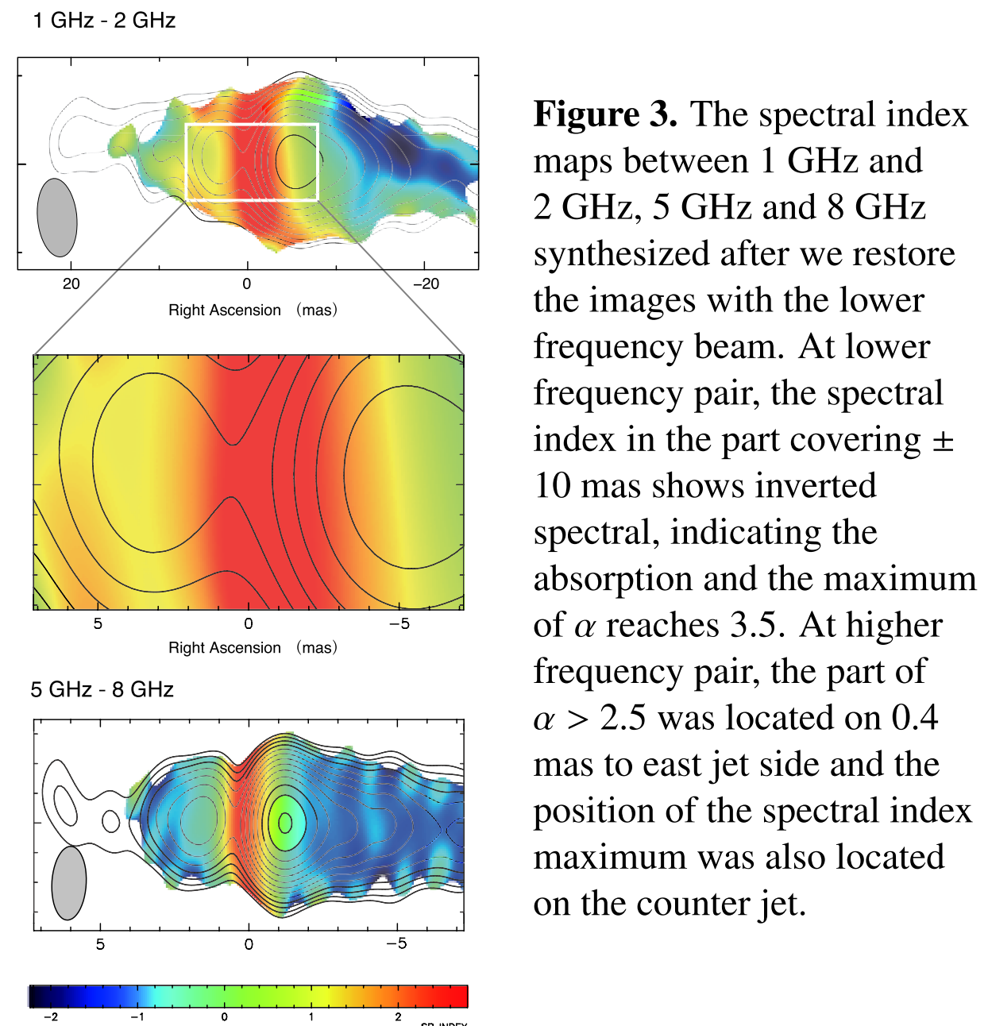
What is the meaning of the radio core?
The implication of this is that, on the side of the core closer to the BH, the spectral index $α$ with $υ∝S^{α}$ is positive and on the other side, negative.
Haga+, EPJWC, 61, 08004 (2013)
Haga, EPJWC, 61, 08004 (2013)

Slide 5
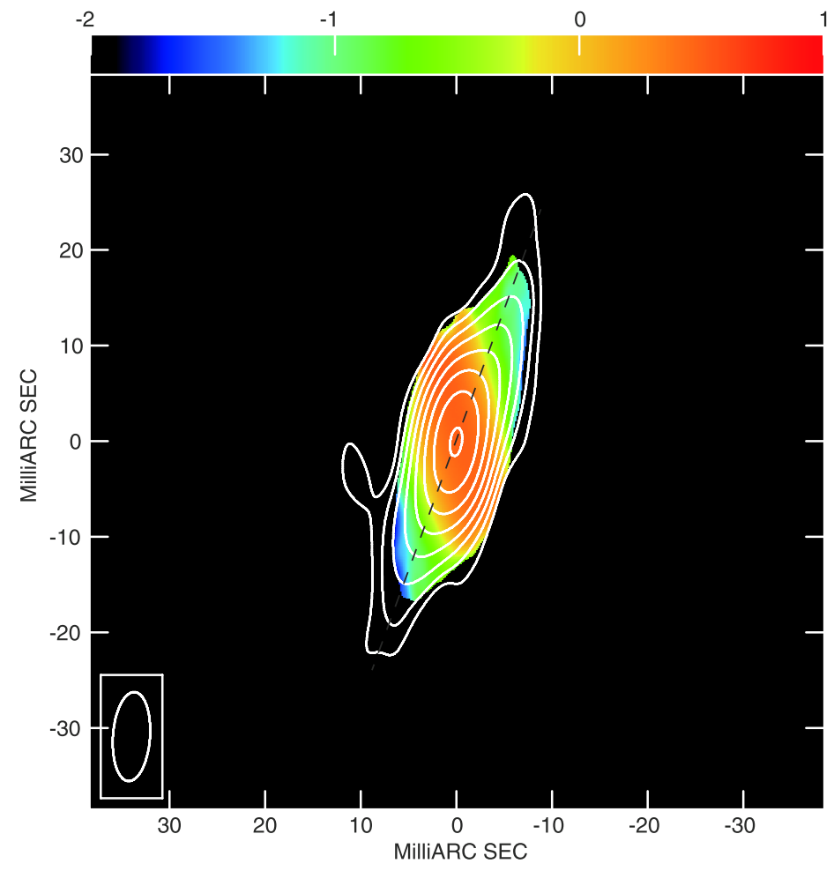
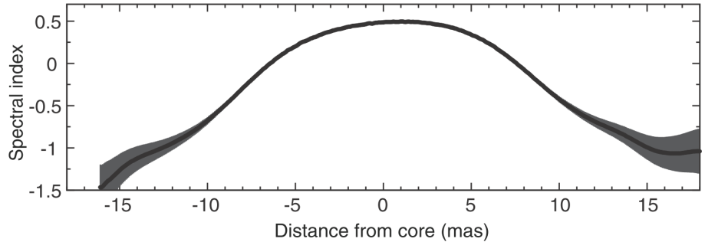
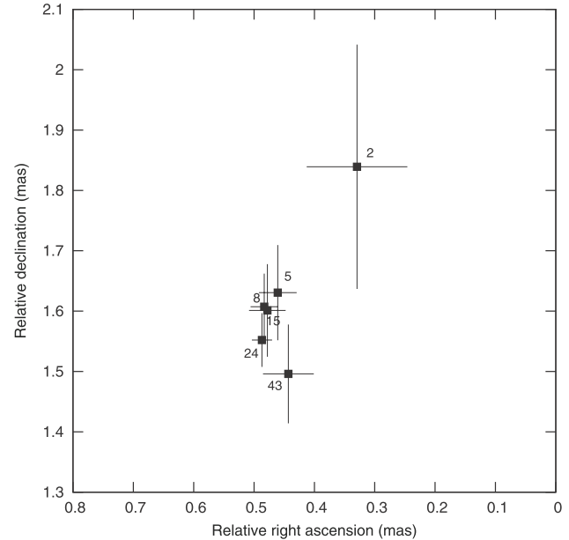
Core shift measurement in M104
Hada, ApJ, 779, 6 (2013)

Slide 6
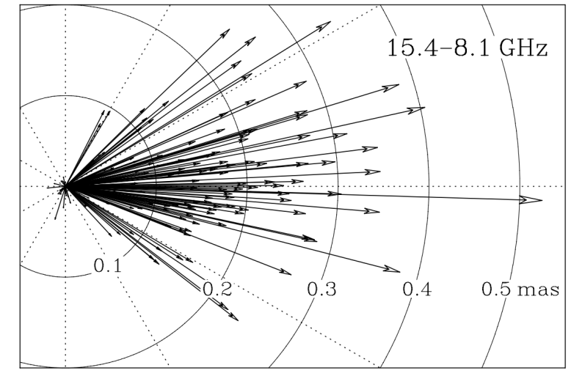
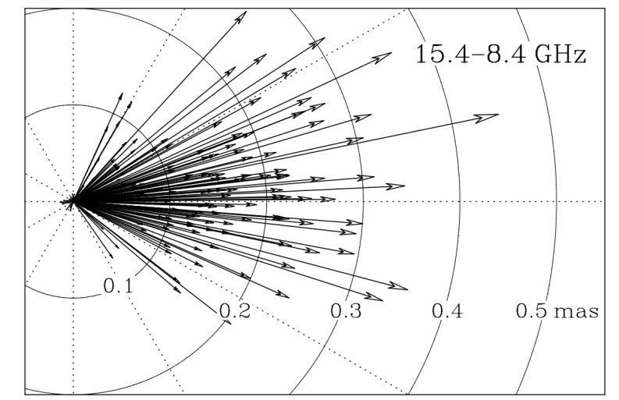
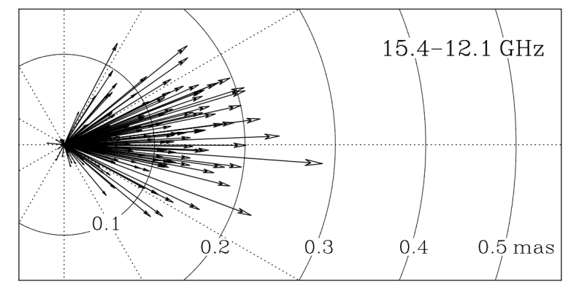
MOJAVE：General Statistics of core shifts
The MOJAVE program has published a core shift study of ~150 AGNs and the results are plotted on the right. It is clear that the general population follows the core shift scheme
Hada+, Nature, 477, 185
Pushkarev, A&A, 545, A113 (2012)
(lower freq. cores are further down the jet). One also finds that the seperation vector between the cores are generally within 45 deg of the jet axis.

Slide 7
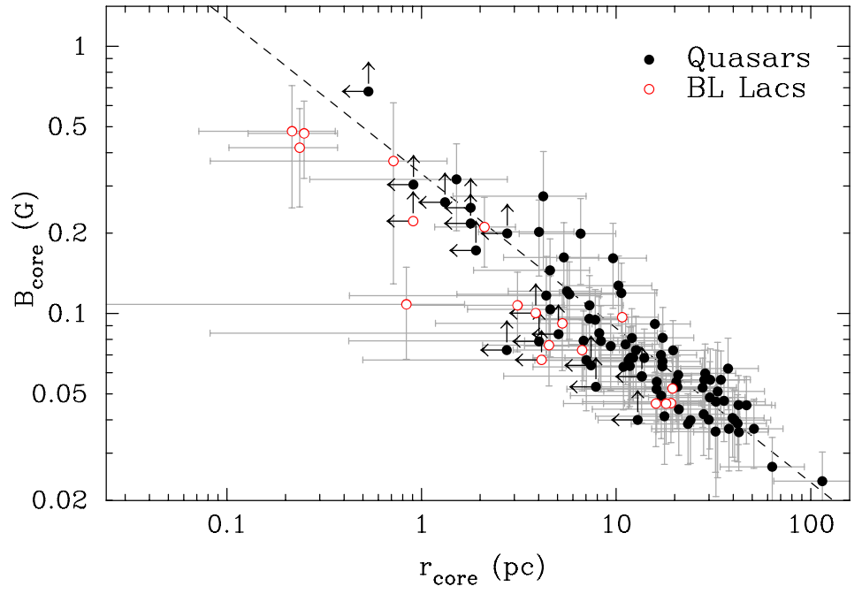
MOJAVE：General Statistics of core shifts
This figure shows that the magnetic field strength basically falls with distance ~ $R^{−1}$.
*I personally think using r_core isn’t a very great way, given a BH mass factor of 10, then the scaling relation with Schwartzschild radii would be an order of magnitude off.
But anyway, what this shows is a general pattern of decreasing B field down the jet.
Pushkarev, A&A, 545, A113 (2012)

